Slide 1
External Quality Assessment of HIV-RT Programme In South Sudan
RT-CQI WORKSHOP-Cape Town, South Africa
June 3-7, 2024
National Public Health Laboratory-South Sudan

Slide 2
Presentation outline
Overview of EQA/PT program
Stakeholders and roles
EQA/PT coverage
Panel production and distribution
Data management
Scale up plans
Lessons learned.

Slide 3
HIV-PT EQA Scheme Overview
2016-2017
2017-2020
2021 To Date
Retesting on DBS
DTS from Kenya
In-House production of HTS-DT Panels
HTS EQA is conducted twice a year.
In HFs, panels are distributed to all testing points i.e. ANC/PMTC, VCT, Lab and other PITC points.
At the community, panels are distributed to the community testers.
An integrated sample referral & coordination system
EQA-Document development (guidelines, SOPs and data tools)
Scale-up from 13 To 49 HTS Facilities

Slide 4
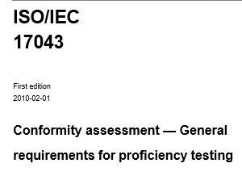
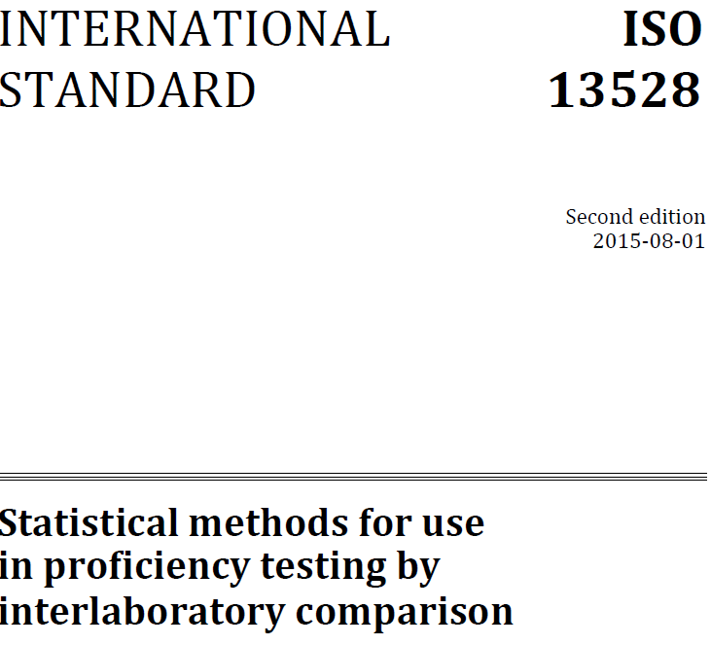
Scheme Quality Management Documents
SOPs are available for PT panel production, report analysis, and EQA program management.

Slide 5
HTS-EQA stakeholders
Stakeholder | Roles
MoH | Provide leadership e.g. resource mobilization, development of strategic plan
 | Play coordinational role e.g. technical working group, stakeholders meeting
 | Provide technical support e.g. development of guideline and SOPs, production and distribution of PT panels
 | Develop and maintain EQA data management tools
 | Monitor and evaluate implementation of EQA programme
Funders (PEPFAR/CDC/GF) | Provide funding for HTS-PT panel production and distribution, capacity building.
Implementing Partners | Provide technical assistance, e.g. capacity building, co-chairing TWG meeting, development of document and guideline .

Slide 6
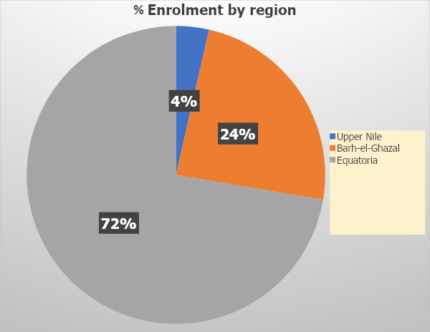
National EQA Coverage
Total number facilities: 243
Total number enrolled: 124
Coverage: 51%
Average response rate: 85-95%

Slide 7
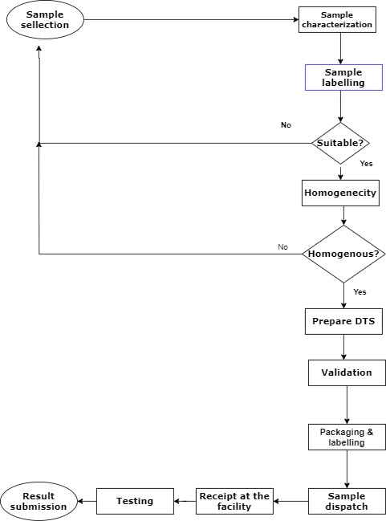
Panel production and distribution process

Slide 8
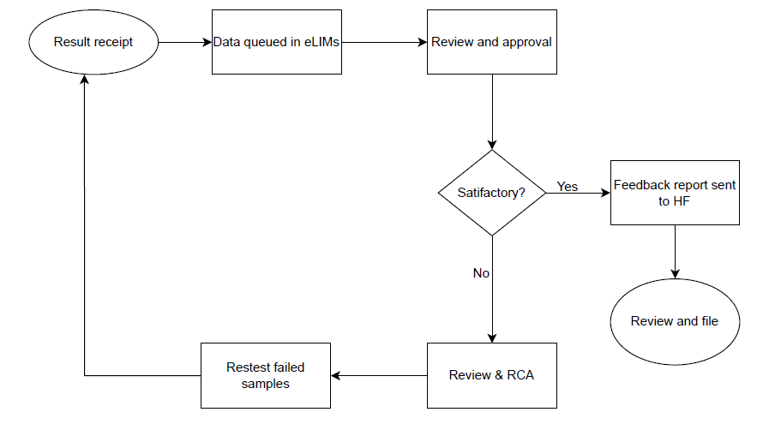
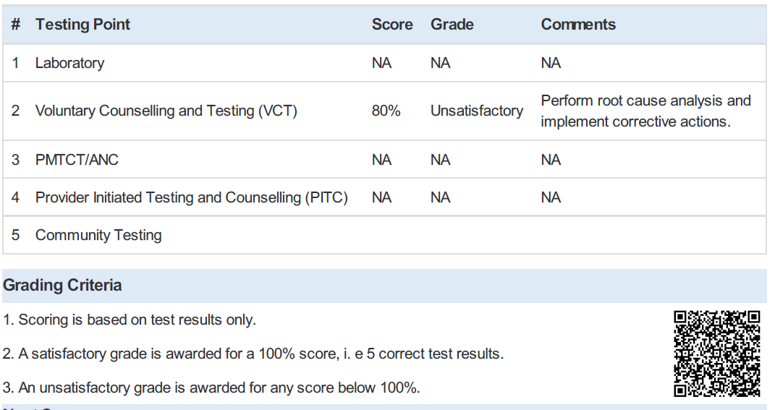
EQA result analysis
Example of unsatisfactory performance

Slide 9
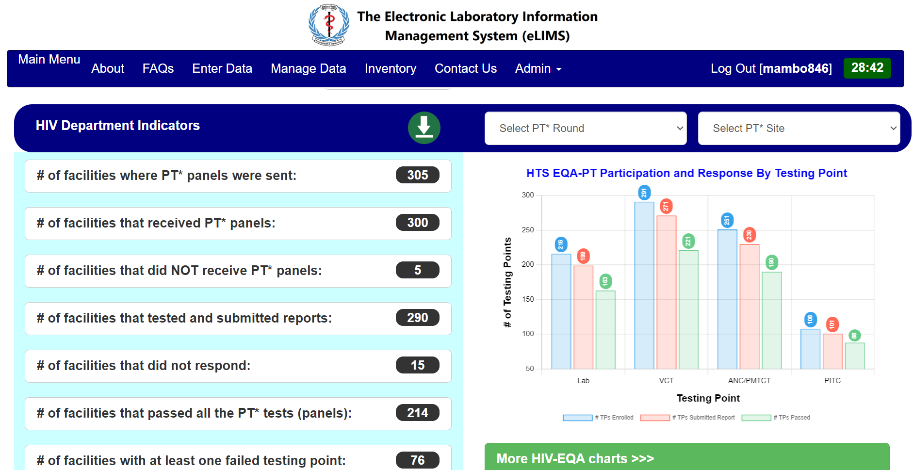
EQA Information Management System

Slide 10
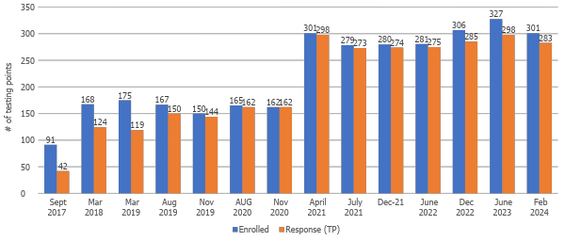
HTS EQA dashboard

Slide 11
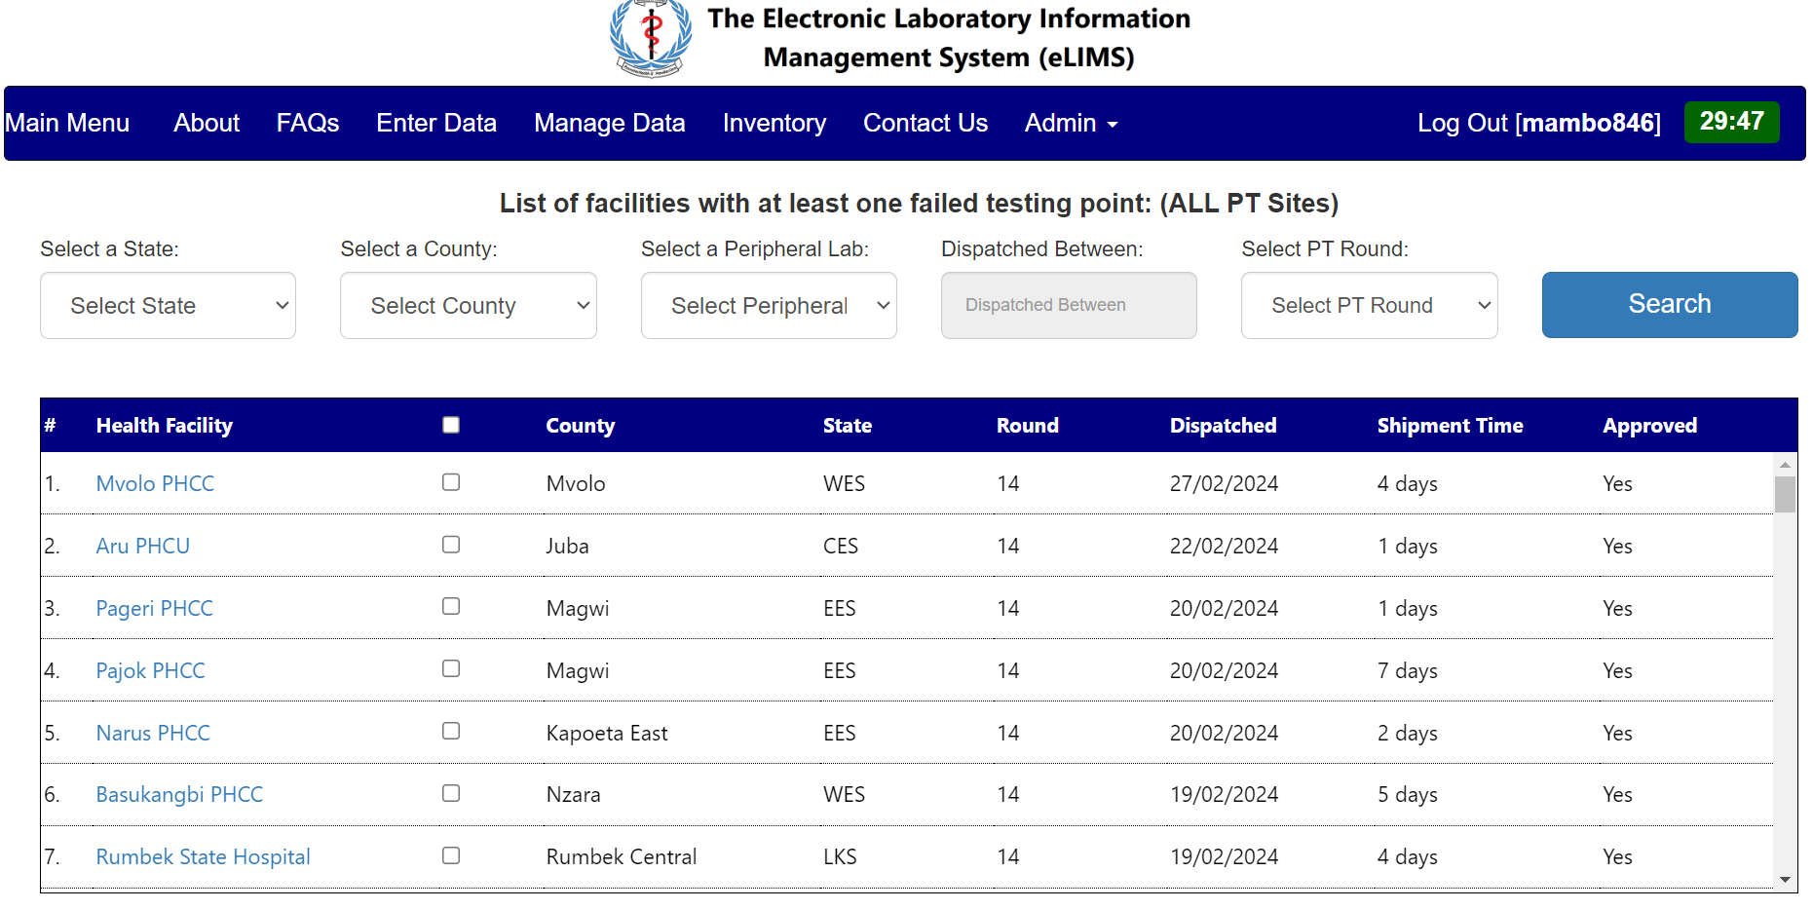
EQA Data utilization
Identification of underperforming facilities
Notes:
Training needs arising from incompetence and attrition
Poor supply management (stock out of test kits, expiration, storage, etc.)
Issues to do with sample & result referral system (last mile delivery, e.g. lose of samples/PT-panels)
Lose of PT-panel integrity

Slide 12
Lessons learned
In-house panel production is cost effective & support sustainability and mass production.
Use of Lab field officers to improve the quality of HTS.
Scale-up and intake of the scheme service requires management will.
Improving infrastructure leads to effective EQA participation and ensure the sustainability of the programme;
Need for collaboration between the government and implementing partners;
Resource mobilization for EQA scheme success;
Continuous monitoring and evaluation of performance;
Building and strengthening the capacity of testers/HTS providers.

Slide 13
Scale-up Plan
Increase the production of PT panels to support scale up, and transition to targeted testers.
Roll out RTCQI for other rapid diagnostic tests including TTIs.
Implement additional improvement projects for facilities that fail subsequent HTS EQA testing.
Monitor effectiveness of the corrective actions done in the next cycle
Train and certify assessors and mentors to implement RTCQI.

Slide 14
Thank you

